Slide 1


Data Science in R
Presentation
Group Members:
Shaheer Sarfraz ( P190026)
Hassam Ud Din ( P190029)

Slide 2
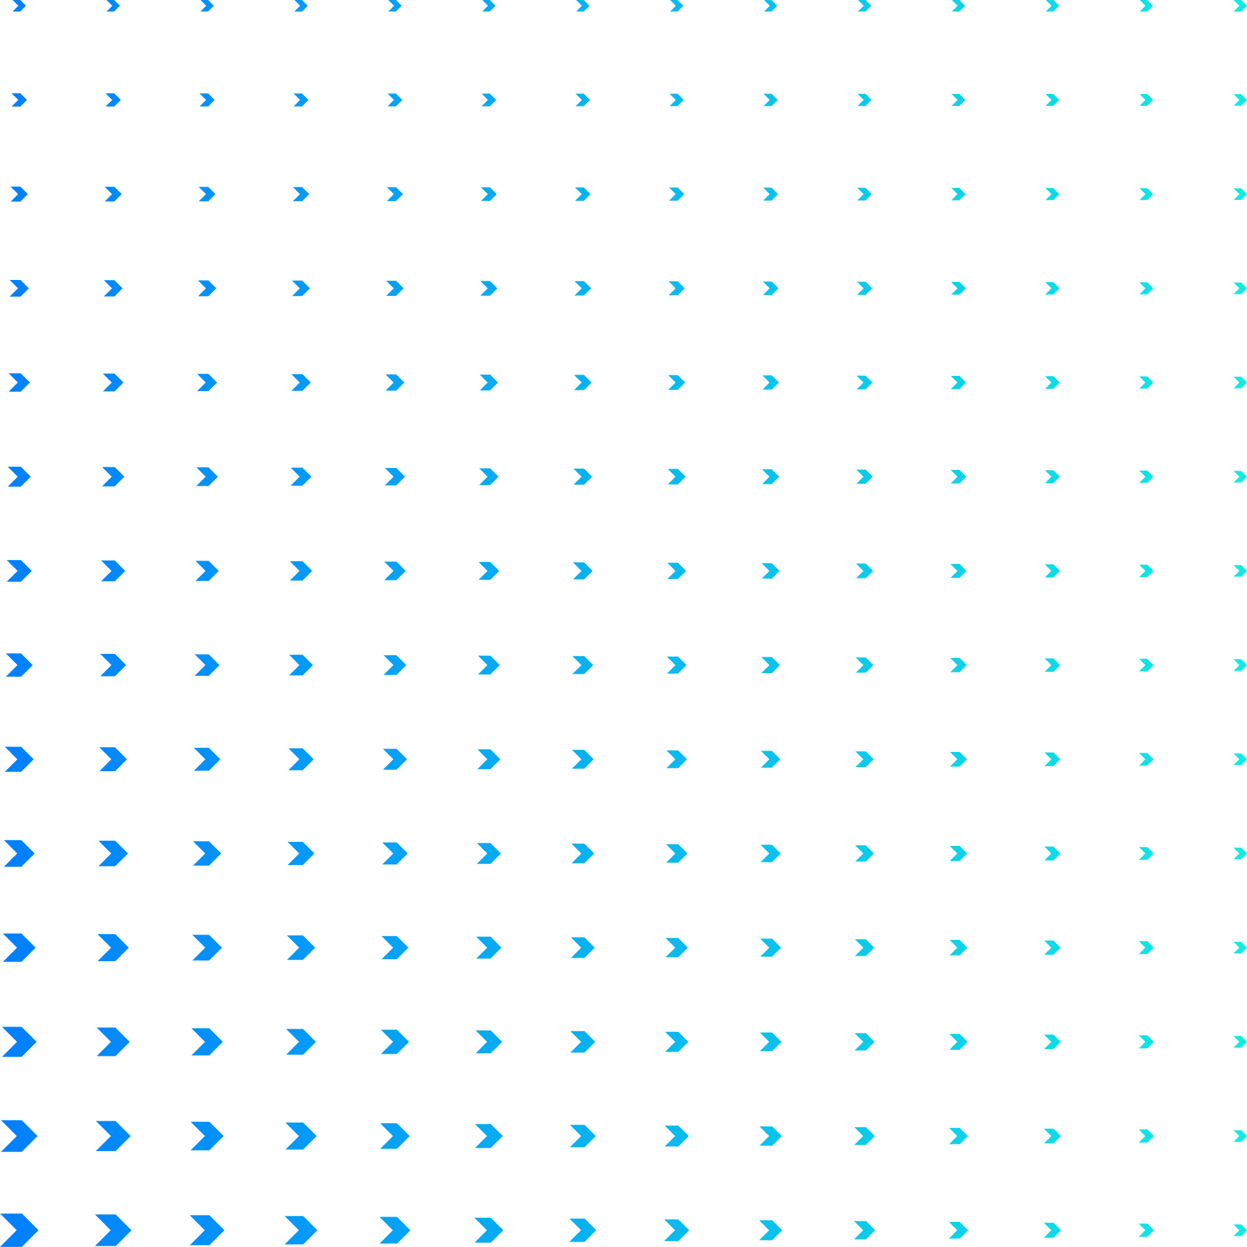
Introduction
Installation
Agenda
Syntax
Packages
Practical

Slide 3

Introduction
R is a programming language for statistical computing and graphics supported by the R Core Team and the R Foundation for Statistical Computing.

Slide 4
Why use R ?
R offers a wide variety of statistics-related libraries and provides a favorable environment for statistical computing and design.

Slide 5

Syntax

Slide 6
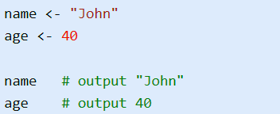

Variables

Slide 7
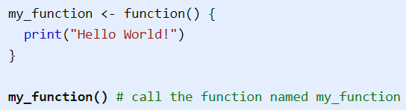
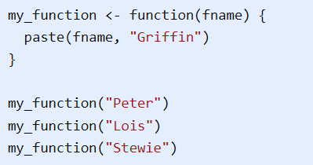
Functions

Slide 8
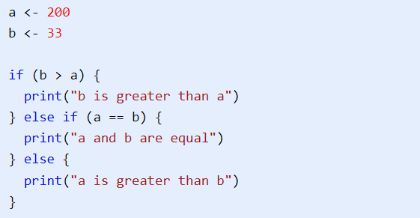
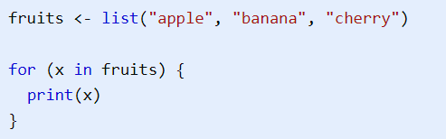
Conditionalsand Loops

Slide 9

Packages

Slide 10
Data Acquisition

Slide 11

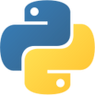
Web Scraping
beautiful soup
rvest
Beautiful Soup is a Python package for parsing HTML and XML documents.
rvest helps you scrape (or harvest) data from web pages.

Slide 12
OCR
tessaract
tessaract
Tesseract is an optical character recognition engine for various operating systems.
Tesseract is an optical character recognition engine for various operating systems.

Slide 13
PDF
pypdf
pdftools
PyPDF2 is a free and open-source pure-python PDF library capable of splitting, merging, cropping, and transforming the pages of PDF files.
pdftools: Text Extraction, Rendering and Converting of PDF Documents.

Slide 14
ETL

Slide 15
ETL
PETL
tidyverse
petl is a general purpose Python package for extracting, transforming and loading tables of data.
The tidyverse is an opinionated collection of R packages designed for data science.

Slide 16
Data Wrangling

Slide 17
Import
pandas
readr
pandas is a software library written for the Python programming language for data manipulation and analysis.
readr package is used to make rectangular data out of comma separated (csv), tab separated (tsv) or fixed width files (fwf) and into R.

Slide 18
Cleaning
pandas
tidyr
pandas is a software library written for the Python programming language for data manipulation and analysis.
tidyr package is used to simplify the process of creating tidy data.

Slide 19
Data Analysis

Slide 20
Analysis
pandas
dplyr
pandas is a software library written for the Python programming language for data manipulation and analysis.
dplyr package provides a set of tools for efficiently manipulating datasets in R..

Slide 21
Data Visualization

Slide 22
Visualization
matplotlib
ggplot2
Matplotlib is a plotting library for the Python programming language and its numerical mathematics extension NumPy
ggplot2 is an open-source data visualization package for the statistical programming language R

Slide 23
Thanks

